Slide 1
Plant Microbial Fuel Cell
By Will Busby

Slide 2
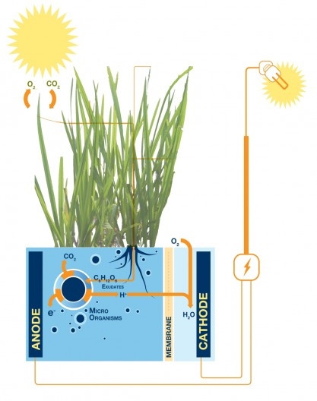
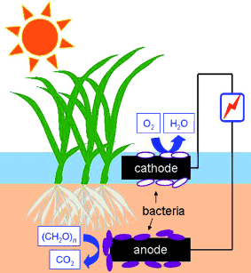

Slide 3
Microbial Fuel Cell (MFC)
transforms chemical energy into electricity using oxidation reduction reactions These are chemical reactions that involve electrons and their movement
Microbial fuel cells rely on bacteria to assist the movement of electrons throughout their systems
harnesses the power of respiring bacteria
convert organic substrates directly into electrical energy

Slide 4
Plant Microbial Fuel Cell
Through photosynthesis, plants convert light energy into potential chemical energy (glucose and other nutrients)
The bacteria oxidize and reduce these molecules that the plants don’t use
Microbes at the anode oxidize the organic fuel generating protons (H⁺) that pass through the membrane to the cathode, and electrons which pass through the anode to an external circuit to generate a current
Different types of bacteria, called exoelectrogens can be used that transfer electrons extracellularly

Slide 5
Com Class
I am taking Intro to Engineering Graphics at College of Marin
We have learned how to create plan drawings (Front, Top, Right, Iso) of objects
This helped improve my design drawings in the class
We have used Solid Works, a 3-D program similar to Inventor and Fusion 360
Throughout the semester, we have done projects that implement our drawing skills
We learned about the process/steps to engineering

Slide 6
Engineering Process
Define problem Brainstorm Research Criteria/Constraints Explore possibilities Select approach Develop a design proposal | Make a model/prototype Test/Evaluate design Refine the design Create/Make solution Communicate Process/Results Documentation throughout

Slide 7
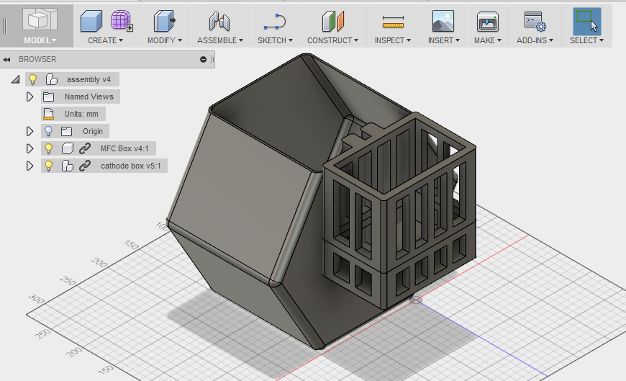
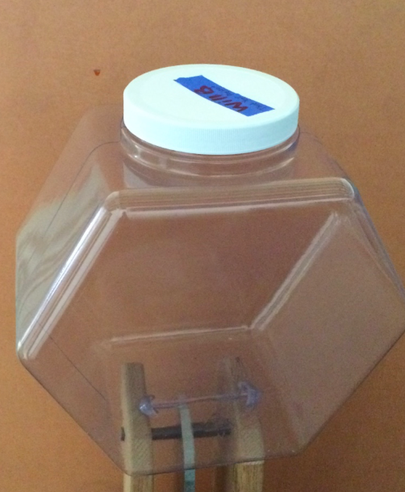
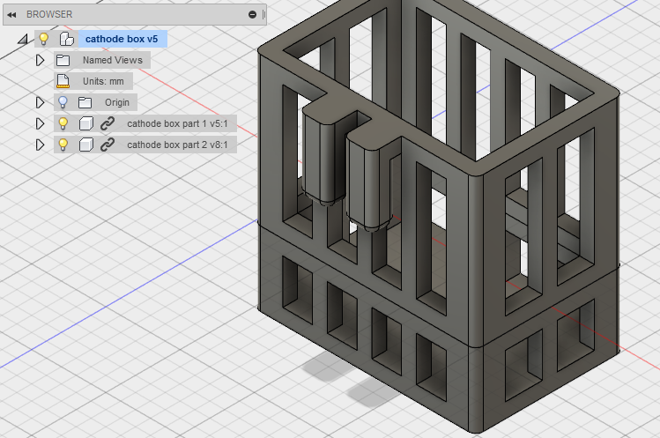

Slide 8
Assistance
I talked to my COM professor and he referred me to the Biology Professor
I have met with and emailed the professor
We talked about the bacteria that I will be using

